Slide 1
Networking Inside of Kubernetes
Team: Alexander Trinh, Fuyao Wang, Zhe Deng,
Geng Song, Zhou Shen
Mentors: Anish Gupta, Bowen Song

Slide 2
Progress
Gossip Node
New key-val store in json format
Sync with Hash
Unit test and cmake

Slide 3
Gossip Node
Structure
A kv storage(LevelDB) with a path to local disk
A list of its neighbors
A list of logs to spread
Functions
Init with basic parameters, and redo all logs
Put/Get/Remove key-value from storage for clients to use
connect/listen to other nodes to sync logs
Store logs in a single file

Slide 4

Logging
Outputting logs to an external file
JSON format
Key will be timestamp
Value will be value received from client and log ID
Using the JSON for Modern C++ Library
Simple library for parsing JSON
Requires only a json.hpp file
Notes:
Again, we will be using logs to reconcile and sync our nodes
Our logs will be outputted to an external file in JSON format
We will have keys and values
The key will be the timestamp of an event, such as when certain data is added
The value will be the actual value received from the client and the log ID
In order to work with JSON, we will be using JSON for Modern C++
This is a simple JSON library that allows us to parse json easily
Only required the inclusion of a single file called json.hpp

Slide 5
Sync with Hash
Why we chose to sync with hash?
Fixed size of log
Reduce size of log
Hash Function: SHA256
Notes:
SHA-256 is novel hash function computed with 32-bit words

Slide 6
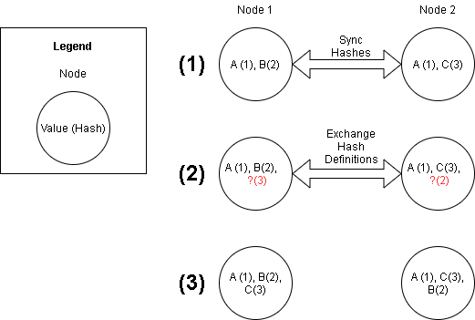
Sync with Hash

Slide 7
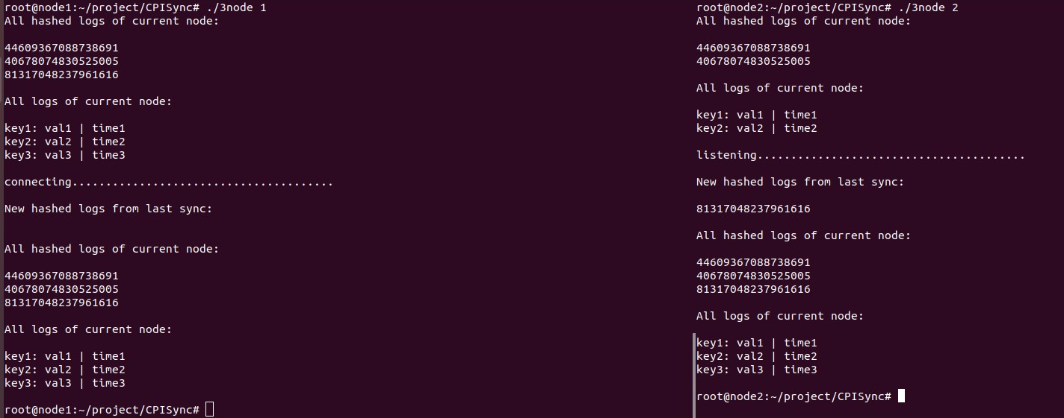
Example in Terminal
Node 1
Node 2
Notes:
Still need to:
Implement larger hash (SHA256)
Currently using a global DB for hash defs. Ideally communicate directly between nodes.

Slide 8
Relation to etcd’s API\MVP
Basic operations:
put
delete
get
Extra features:
snapshot
watch
member add/remove
Notes:
Assumptions:Idempotent operations easy to implement. Latest change is applied. all nodes synced via atomic clock. There is an external method to calculate distance between a client and a node as well as between two nodes. We are dealing with metadata anyways, so writing portions of values are not our first priority.
Basic operations:
Idempotent (for a series of operations on a piece of data, only the last operation matters)
Eventually consistent, performed on closest node to client and then synced
Extra features:
Watch - Still done per node (local). Notifies client when key(s) are changed via log commit.
Snapshot- save one node’s state and logs (use leveldb API). Save node neighbors and names of all db instances (global).
Member add/remove - update neighbors and add a new node (global).

Slide 9
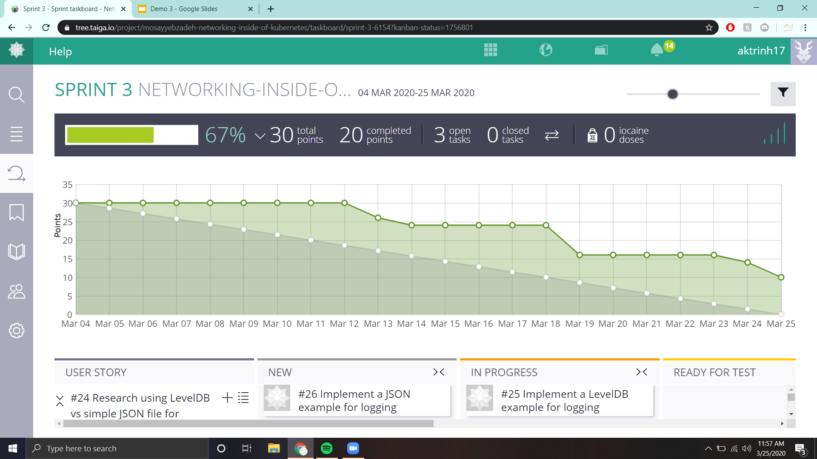
Notes:
First week was spring break, so not too much was completed
After, we started to complete tasks and burning down
Right now we still have a few remaining tasks to complete which we will carry over into the next sprint

Slide 10
Next Steps
Interprocess communication (hash definitions)
Combine nodes and log parsing to commit actions to disk
Log garbage collection
Benchmark

